Slide 1



Slide 2



Domain: Consumer Goods | Function: Executive Management
tliQ
HARDWARE
Consumer Goods
Ad_Hoc Insights
Presentation by : MADHUPA SAMANTA
College Teacher, Aspiring Data Analyst

Slide 3
AGENDA
10 ad hoc requests and Insights
Project Execution process
Company’s background & overview
Problem statement
Some additional insights
Summary
1.
2.
3.
4.
5.
6.

Slide 4
Problem statement
One of the top manufacturers of computer hardware in India, AtliQ Hardware is also well-established in other countries outside India.
The management did note, nevertheless, that they do not obtain sufficient insights to enable them to take prompt, wise, and data-informed judgements. They intend to grow their workforce of data analysts by hiring additional young data analysts.
Its data analytics director, Tony Sharma, sought a candidate with strong technical and soft skill sets. So, he made the decision to run a SQL challenge that would enable him to better comprehend both talents.

Slide 5
PROJECT EXECUTION PROCESS
Loading AtliQ’s database “gdb023” provided by AtliQ’s data analyst Tony Sharma, in MySQL
Understanding AtliQ’s background and data related to company’s customers, products, sales, manufacturing costs etc by running sql queries in MySQL
Query 10 ad hoc requests in MySQL
Then storing the query results as View in MySQL
Loading all the views in Power BI for visualization
Then document the INSIGHTS in PowerPoint presentation.

Slide 6
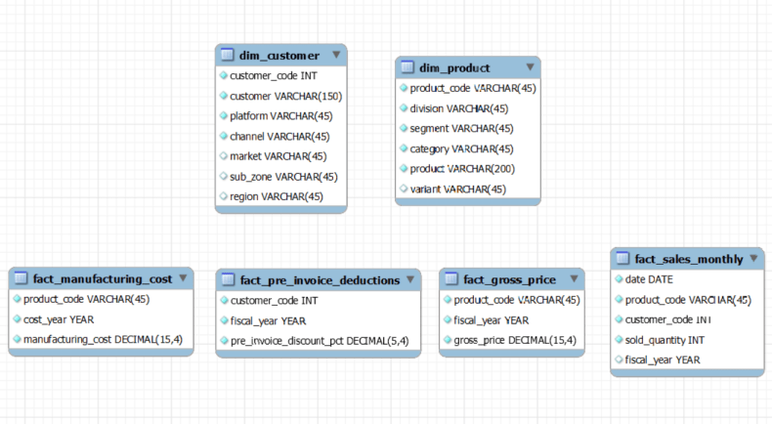
Understanding Data
Overview of the tables found in the 'gdb023' (atliq_hardware_db) database :
1. dim_customer:
contains customer-related data
2. dim_product:
contains product-related data
3. fact_gross_price:
contains gross price information for each product
4. fact_manufacturing_cost:
contains the cost incurred in the production of each product
5.fact_pre_invoice_deductions:
contains pre-invoice deductions information for each product
6. fact_sales_monthly: contains monthly sales data for each product.

Slide 7
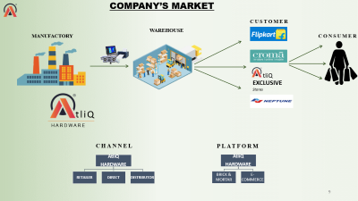
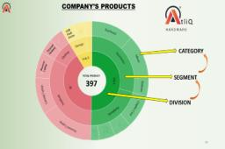
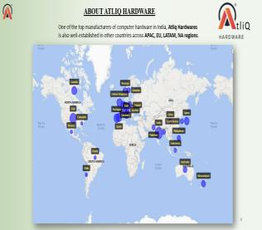
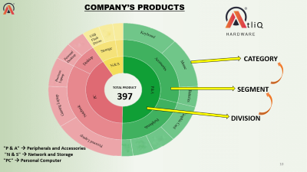
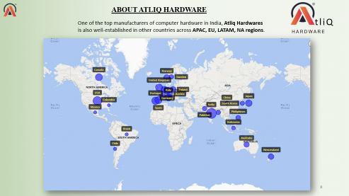
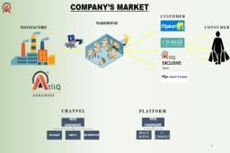
Company’s background & overview
tliQ
HARDWARE

Slide 8
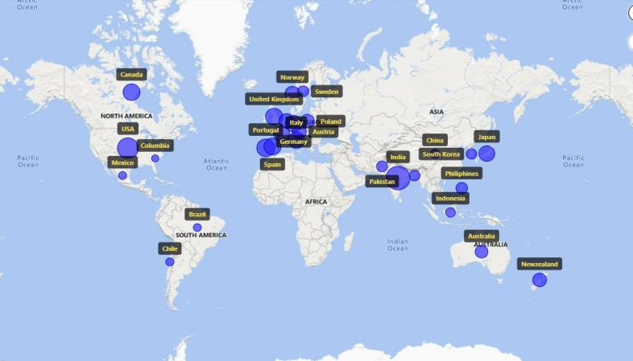
ABOUT ATLIQ HARDWARE
tliQ
One of the top manufacturers of computer hardware in India, Atliq Hardwares is also well-established in other countries across APAC, EU, LATAM, NA regions.
HARDWARE

Slide 9








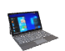

COMPANY’S MARKET
CUSTOMER
WAREHOUSE
MANUFACTORY
CONSUMER
tliQ
EXCLUSIVE Stores
tliQ
HARDWARE
CHANNEL
PLATFORM
AtliQ
HARDWARE
RETAILER
DIRECT
DISTRIBUTOR
AtliQ
HARDWARE
BRICK & MORTAR
E-COMMERCE

Slide 10
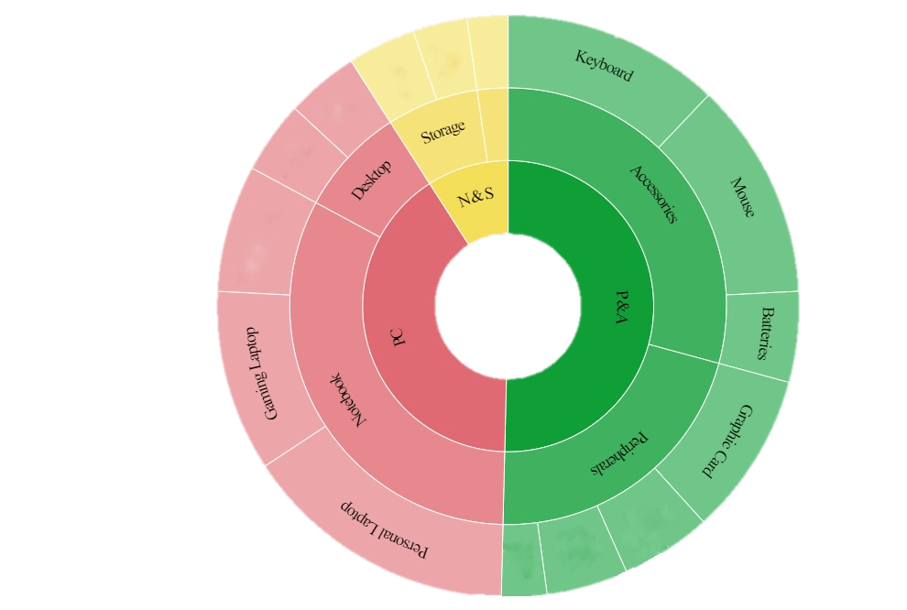
COMPANY’S PRODUCTS
tliQ
USB
Flash
Drives
USB
Flash
Drives
HARDWARE
Personal
Desktop
Personal
Desktop
CATEGORY
Business
Laptop
Business
Laptop
TOTAL PRODUCT
SEGMENT
397
DIVISION
"P & A" → Peripherals and Accessories
"N & S" → Network and Storage
"PC" → Personal Computer

Slide 11
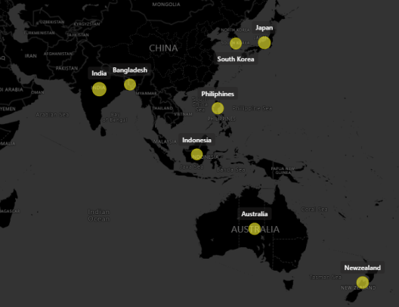
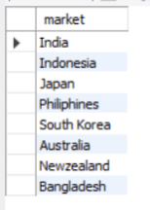

REQ. 1
Provide the list of markets in which customer "Atliq Exclusive" operates its business in the APAC region
“Atliq Exclusive” market in APAC region
SOLUTION :
INSIGHTS:
"Atliq Exclusive“ operates its business in 8 countries in APAC region
Of these, India has the highest number of customers.

Slide 12
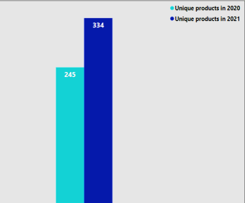
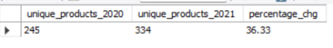
REQ. 2
What is the percentage of unique products increase in 2021 vs. 2020?
( The final output contains these fields --
unique_products_2020, unique_products_2021, percentage_chg )
Unique products count – 2020 vs 2021
SOLUTION :
36.33 %
Rise
INSIGHTS:
We observe a 36.33% upgrade in the number of unique products from 2020 to 2021
AtliQ is well competing with their competitors and discovering market opportunities by launching new products. This tactic helps to attract new potential customers and ring up sales for both old and new products
2021
2020

Slide 13
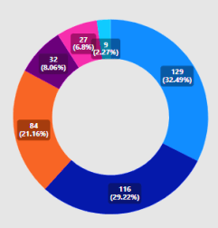
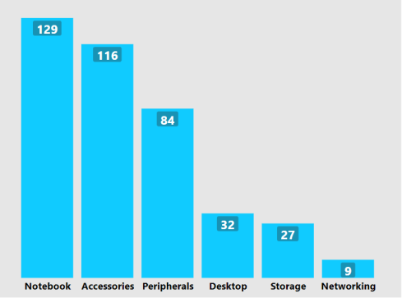
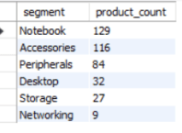
REQ. 3
Provide a report with all the unique product counts for each segment and sort them in descending order of product counts.
(The final output contains 2 fields - segment, product_count )
SOLUTION :
Segment wise Product count
INSIGHTS:
The most unique products are found in the Notebook segment
This segment wise analysis aids AtliQ in determining where attention should be paid to aim growth

Slide 14
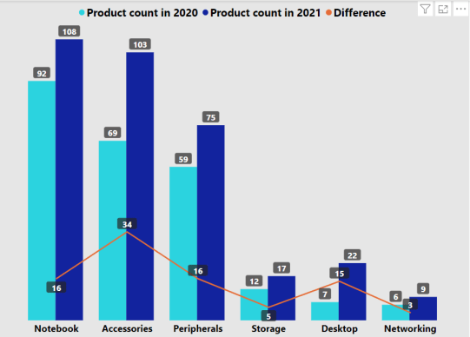
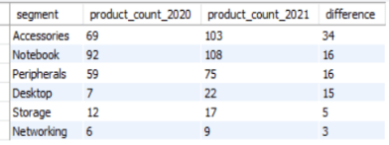
REQ. 4
Which segment had the most increase in unique products in 2021 vs 2020?
(The final output contains these fields -- segment product_count_2020, product_count_2021 difference)
SOLUTION :
INSIGHTS:
Accessories segment had the most increase(34) in unique products from 2020 to 2021.
Percentage of change in product count from 2020 to 2021 had skyrocketed by 214% in desktop segment
N & S division(Networking and Storage segments) had the least increase(8) in products from 2020 to 2021.

Slide 15
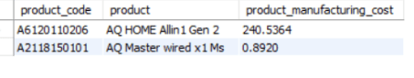
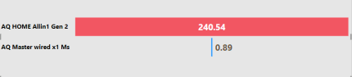
REQ. 5
Get the products that have the highest and lowest manufacturing costs.
(The final output should contain these fields -- product_code, product, manufacturing_cost)
SOLUTION :
INSIGHTS:
The personal desktop “ AQ HOME Allin1 Gen 2 ” has the highest and the mouse “ AQ Master wired x1 Ms ” has the lowest manufacturing costs
Determining manufacturing costs can help manufacturer to quote and price their products most profitably. AtliQ’s product developer can re-evaluate AQ HOME Allin1 Gen 2 to reduce manufacturing cost
(labor, material, energy, and machinery costs) while still maintaining quality and performance.

Slide 16
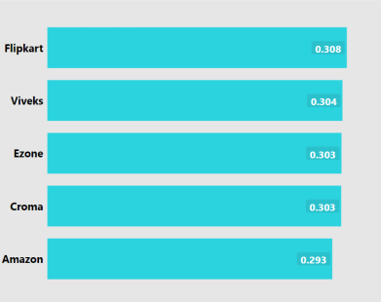
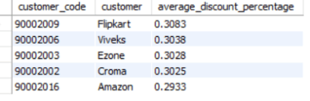
REQ. 6
Generate a report which contains the top 5 customers who received an average high pre_invoice_discount_pct for the fiscal year 2021 and in the Indian market.
(The final output contains these fields -- customer_code, customer, average_discount_percentage)
Top 5 customers
SOLUTION :
INSIGHTS:
Among AtliQ’s top 5 customers getting average high pre invoice discount exclusively in INDIAN market are Brick & Mortar retailer Vivek, Ezone and Croma and the E- commerce retailer Amazon, Flipkart
Of these, Flipkart is the most valuable customer of Indian market in fiscal year 2021 receiving highest pre-invoice discount of 30%

Slide 17
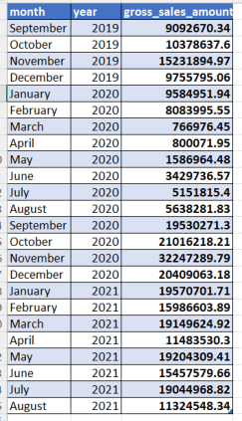
REQ. 7
Get the complete report of the Gross sales amount for the customer “Atliq Exclusive” for each month . This analysis helps to get an idea of low and high-performing months and take strategic decisions.
(The final report contains these columns: Month, Year , Gross sales Amount )
SOLUTION :
Fiscal year of AtliQ :
September – August
Fiscal year 2020 ---> Sept 2019- Aug 2020
(FY 2020)
Fiscal year 2021 ---> Sept 2020- Aug 2021
(FY 2021)

Slide 18
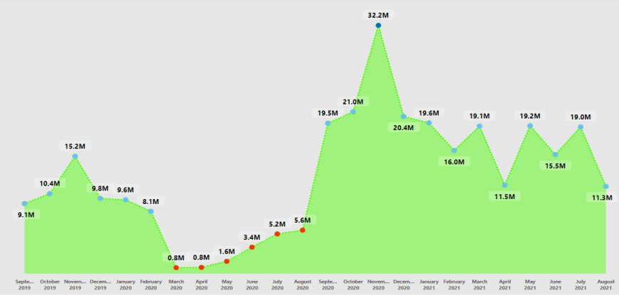
Gross sales trend for “AtliQ Exclusive”
Highest sales
Lowest sales
INSIGHTS:
Being a physical store AtliQ-Exclusive’s gross sales had significantly dropped during the lockdown period between March and August in FY 2020 due to COVID 19. However AtliQ recovered quickly after August and in November, it experienced the highest sales in last two fiscal years.

Slide 19
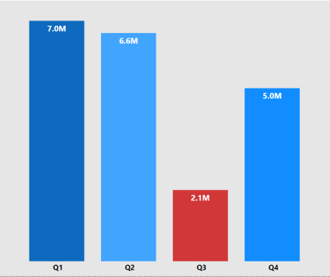
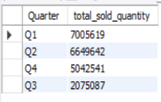
REQ. 8
In which quarter of 2020, got the maximum total_sold_quantity?
(The final output contains these fields sorted by the total_sold_quantity : Quarter, total_sold_quantity)
Total sold quantity Quarter wise
SOLUTION :
143 %
INSIGHTS:
Quarter 1 (sept 2020- nov 2020) of FY 2020 got the maximum total sold quantity
The sales dropped drastically in Q3(March, April, May) of FY 2020 due to shutdown in Covid 19.
AtliQ survived quickly from pandemic and its sales skyrocketed by 143 % in Q4 from Q3. The hit was probably due to high demand of desktop, laptop for sudden rise of online classes, online conference, meetings, WFH in the shutdown period. Also AtliQ’s 72% customers are E-commerce and AtliQ upgraded their products in high demanding desktop segment, which is 214% (ref. req 4).
So AtliQ played strategically and took advantage of its strengths, which paid off.

Slide 20
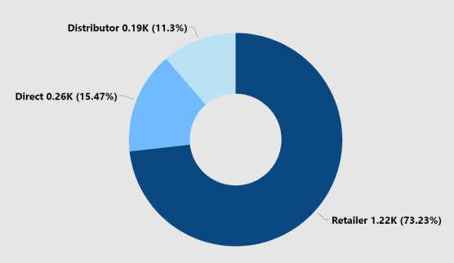
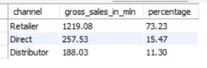
REQ. 9
Which channel helped to bring more gross sales in the fiscal year 2021 and the percentage of contribution?
(The final output contains these fields: channel, gross_sales_mln, percentage)
AtliQ’s Customer
Retailer
78.47%
Direct
(19.14%)
Distributor
2.39%
Gross sales in fiscal year 2021 (Channel wise)
SOLUTION :
INSIGHTS:
Retailer accounted for the majority of sales in AtliQ, which is 73.23% of total sales in fiscal year 2021.
Direct and Distributor bring 15.47% and 11.3% gross sales accordingly in fiscal year 2021

Slide 21
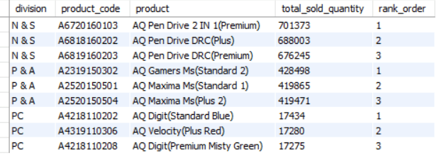
REQ. 10
Get the Top 3 products in each division that have a high total_sold_quantity in the fiscal_year 2021? (The final output contains these fields: division, product_code)
SOLUTION :
Top 3 products by sold quantity in FY 2021 (Division-wise)

Slide 22
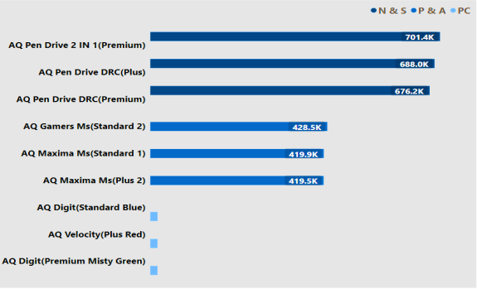
REQ. 10
Top 3 products by sold quantity in FY 2021 (Division-wise)
17.4K
17.2K
17.2K
INSIGHTS:
Top 3 products by sold quantity in FY 2021 are different variant of Pen Drives in N & S division, different variant of Mouse in P & A division and different variant of Personal laptop in PC division.

Slide 23
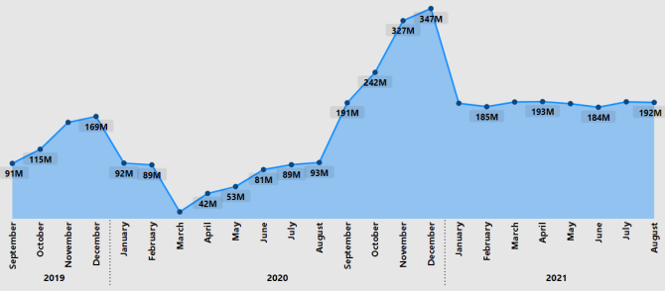
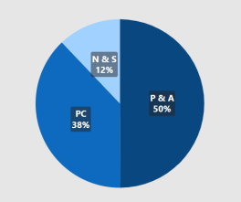
SOME ADDITIONAL INSIGHTS
Month wise Gross Sales of AtliQ in FY 2020 to FY 2021
Division wise gross sales amount
in FY 2021
Fig. 2
Fig. 1
Fig 1 depicts a clear picture of pandemic effect on overall AtliQ’s sales
Of the divisions of AtliQ, though N&S division sold the highest quantity (ref.--> Req. 10), but it contributed the least (12%) of total gross sales amount in FY 2021. P&A division contributed the highest here.
(ref.→ fig 2)

Slide 24
SUMMARY
Consolidating all :
AtliQ’s gross sales increased in FY 2021.
AtliQ is changing and modifying its products which has become a profitable exercise.
Network & Storage division sold maximum quantity product in FY 2021. Although it brought only 12% of total gross sales amount. Also considering the fact that this division had the least modification of product, I would like to suggest AtliQ to revise products sale price and introduce new products in Network & Storage division.

Slide 25
My GitHub link : https://github.com/MadhupaSamanta/Codebasic-Resume-project-Ad-hoc-Insights
Codebasic Resume Project Challenges link : https://codebasics.io/challenge/codebasics-resume-project-challenge

Slide 26

Presentation by : MADHUPA SAMANTA
College Teacher, Aspiring Data Analyst

